Slide 1

VLSI · IECON 2026 CANDIDATE PAPER
An Activity-Rate-Aware Hysteresis
Controller for Adaptive Power Gating
Eliminating sleep-mode thrashing in SoC blocks — without machine learning
Joud Thaher · Layan Salem
Supervised by Dr. Khader Mohammed
Department of Electrical and Computer Engineering — Birzeit University

Slide 2
01 THE PROBLEM
Static thresholds can't tell idle apart
from busy-with-gaps
Leakage power now dominates total power as nodes shrink.
Power gating helps — but most controllers sleep after a fixed idle-cycle count, regardless of why the gap occurred.
Bursty traffic with short gaps above that threshold causes repeated sleep/wake cycles — thrashing.
A bursty workload, seen by a fixed threshold
idle-cycle threshold
● activity ● false wake-up trigger
Each wake-up costs latency and energy — savings from sleeping briefly can cost more than they save.
Activity-Rate-Aware Hysteresis Power Gating
2

Slide 3



02 OUR IDEA
Gate sleep entry on idle count
AND activity rate — not idle count alone
Idle-cycle
count
Activity
rate
Sleep
request
Comparator-only logic — no multipliers, no learned models
AND
Adaptive threshold widening suppresses sleep during bursts
When recent activity is high, both thresholds widen — bursty traffic no longer reads as idle.
Fair, single-module-substitution comparison isolates the real variable
Activity-Rate-Aware Hysteresis Power Gating
3

Slide 4
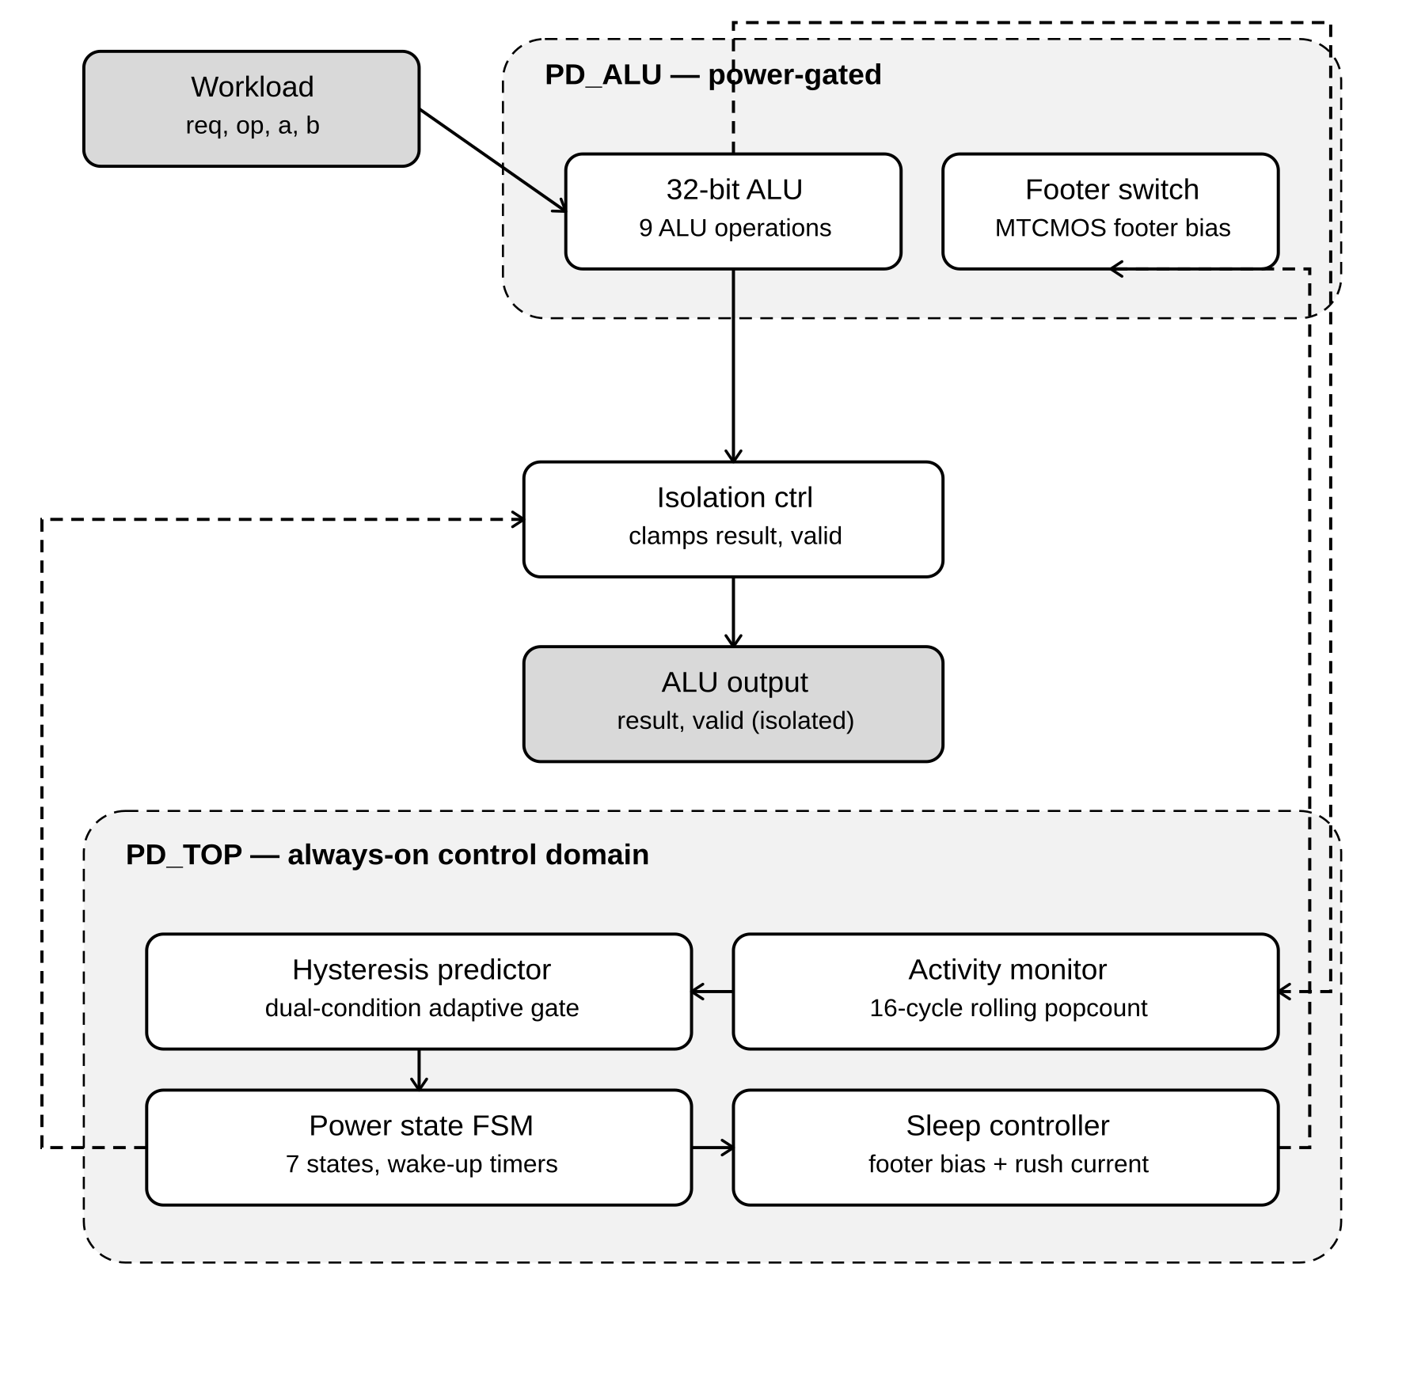
03 ARCHITECTURE
Two power domains, six modules,
one substituted block
PD_TOP — always-on control domain (monitor, predictor, FSM, sleep controller)
PD_ALU — power-gated domain (32-bit ALU + MTCMOS footer switch)
The hysteresis predictor is the controller's only novel block
Activity-Rate-Aware Hysteresis Power Gating
4

Slide 5
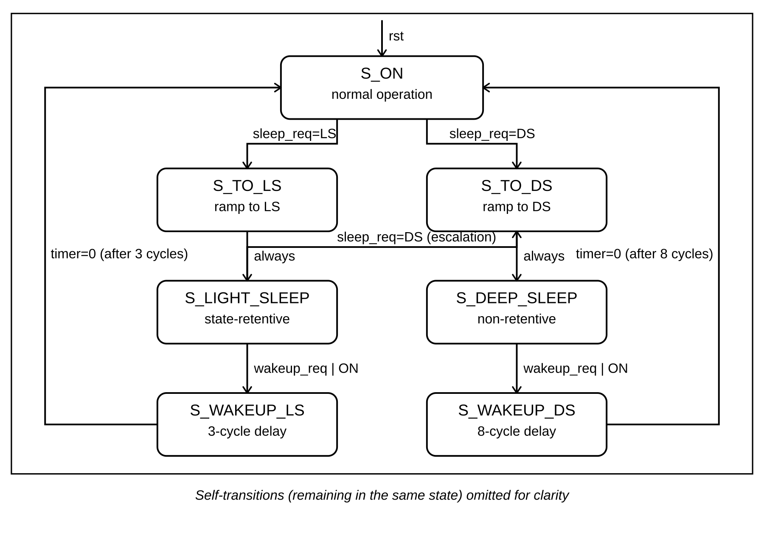
03 ARCHITECTURE
Seven states govern every transition
3
8
cycles · LS wake-up
cycles · DS wake-up
Activity-Rate-Aware Hysteresis Power Gating
5

Slide 6
04 METHOD
One module swapped.
Everything else identical.
Baseline
Proposed
32-bit ALU
32-bit ALU
Activity monitor
Activity monitor
Power-state FSM
Power-state FSM
Sleep controller
Sleep controller
Isolation control
Isolation control
UPF power intent
UPF power intent
Fixed-threshold predictor
Hysteresis predictor (novel)
only variable that differs
Activity-Rate-Aware Hysteresis Power Gating
6

Slide 7



05 EXPERIMENTS
Three workloads, identical stimulus,
both designs
BURST
SPARSE
MIXED
Short bursts, gaps above the baseline's fixed threshold
Long, unambiguous idle periods
Alternating dense and sparse phases
Synopsys VCS · Design Compiler · IC Compiler II · SAED14LVT 14 nm
Activity-Rate-Aware Hysteresis Power Gating
7

Slide 8
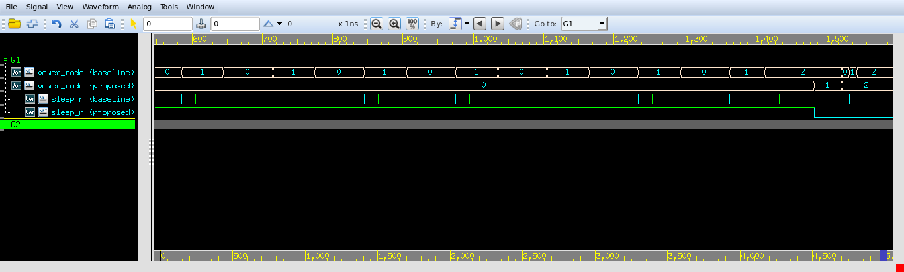
06 RESULTS
Zero transitions vs. nineteen
BURST workload — power_mode and sleep_n, baseline vs. proposed
19 → 0
9 → 0
19.3% → 59.3%
throughput
mode transitions
wake-up events

Slide 9
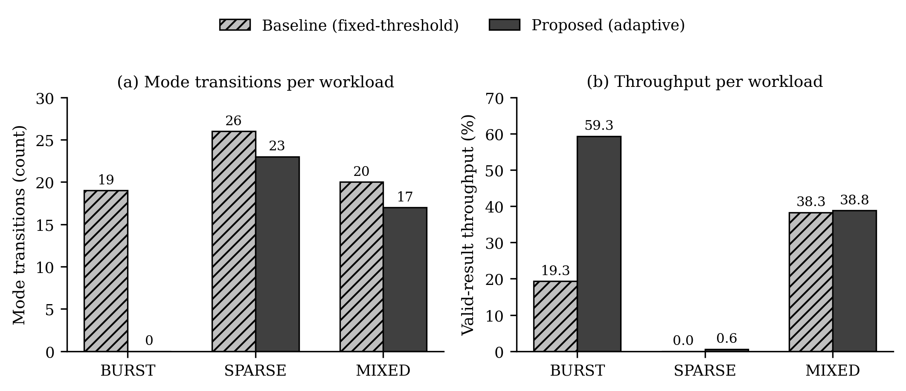
06 RESULTS
Stable under bursts. Equally efficient
when truly idle.
Sparse workload: 33.4% vs. 31.6% leakage saving — within measurement noise, not a real penalty.
Activity-Rate-Aware Hysteresis Power Gating
9

Slide 10
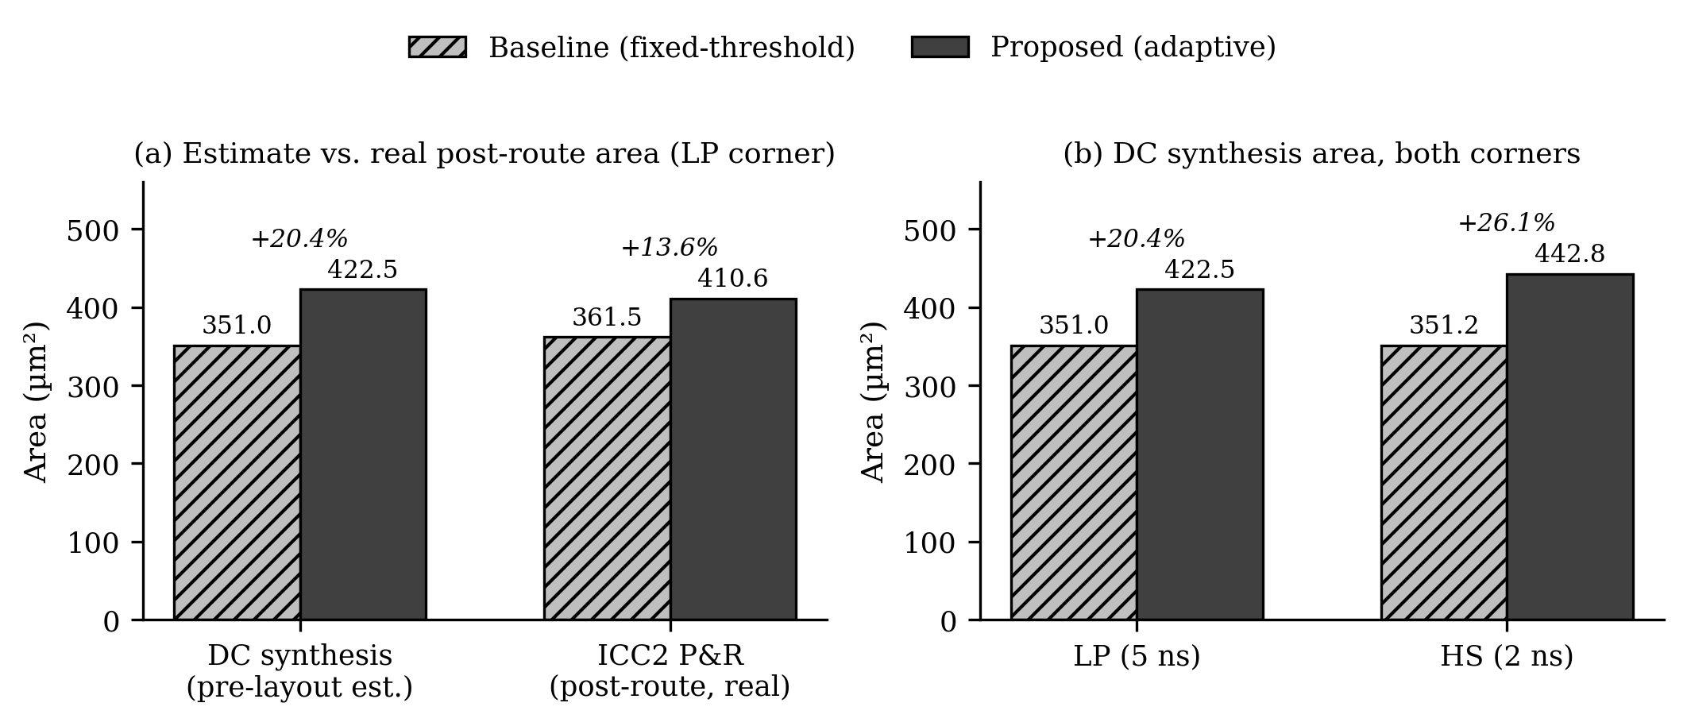
06 RESULTS
A bounded cost for a real behavioral win
+13.6% real post-route area · WNS = TNS = 0.0000 ns on both designs
Activity-Rate-Aware Hysteresis Power Gating
10

Slide 11
07 DISCUSSION
Where this sits against prior work
Approach
Decision input
ML hardware?
Outcome
Agarwal et al. — multi-level gating
Idle-count only
No
Thrashes under bursts
Karthikeyan et al. — multi-core ML
Learned classifier
Yes (ML)
Sized for multi-core, not one block
This work
Idle-count + activity rate
No (comparators)
Bounded +13.6% area, zero thrashing
Activity-Rate-Aware Hysteresis Power Gating
11

Slide 12

08 LIMITATIONS
What this doesn't claim — yet
Energy comparisons use a derived metric (transitions × wake-up latency), not a first-principles joule measurement
Post-route results cover a single corner; multi-corner PVT analysis was outside this project's scope
Workloads are synthetic, designed to probe threshold-crossing behavior — not drawn from a real application trace
Future work: extend the activity-rate gate to other block types, multi-corner verification, and real application traces.
Activity-Rate-Aware Hysteresis Power Gating
12

Slide 13

CONCLUSION
Comparator logic. Real silicon.
One clear trade-off.
3.1×
13.6%
0
throughput under burst traffic
real post-route area overhead
timing slack — both designs
Results confirm the proposed design eliminates sleep-state thrashing while converging to baseline-level savings under genuinely idle conditions — at a real, bounded silicon cost.

Slide 14
Thank you.
Questions?
Joud Thaher · Layan Salem
Supervised by Dr. Khader Mohammed
Department of Electrical and Computer Engineering — Birzeit University

